Slide 1
Chicago IL
New York NY
Denver CO
City State
Los Angeles CA
Miami FL

Slide 2
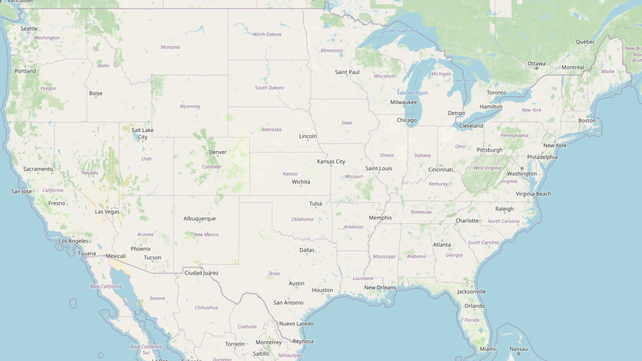
Chicago IL
New York NY
Denver CO
City State
Los Angeles CA
Miami FL

